Slide 1
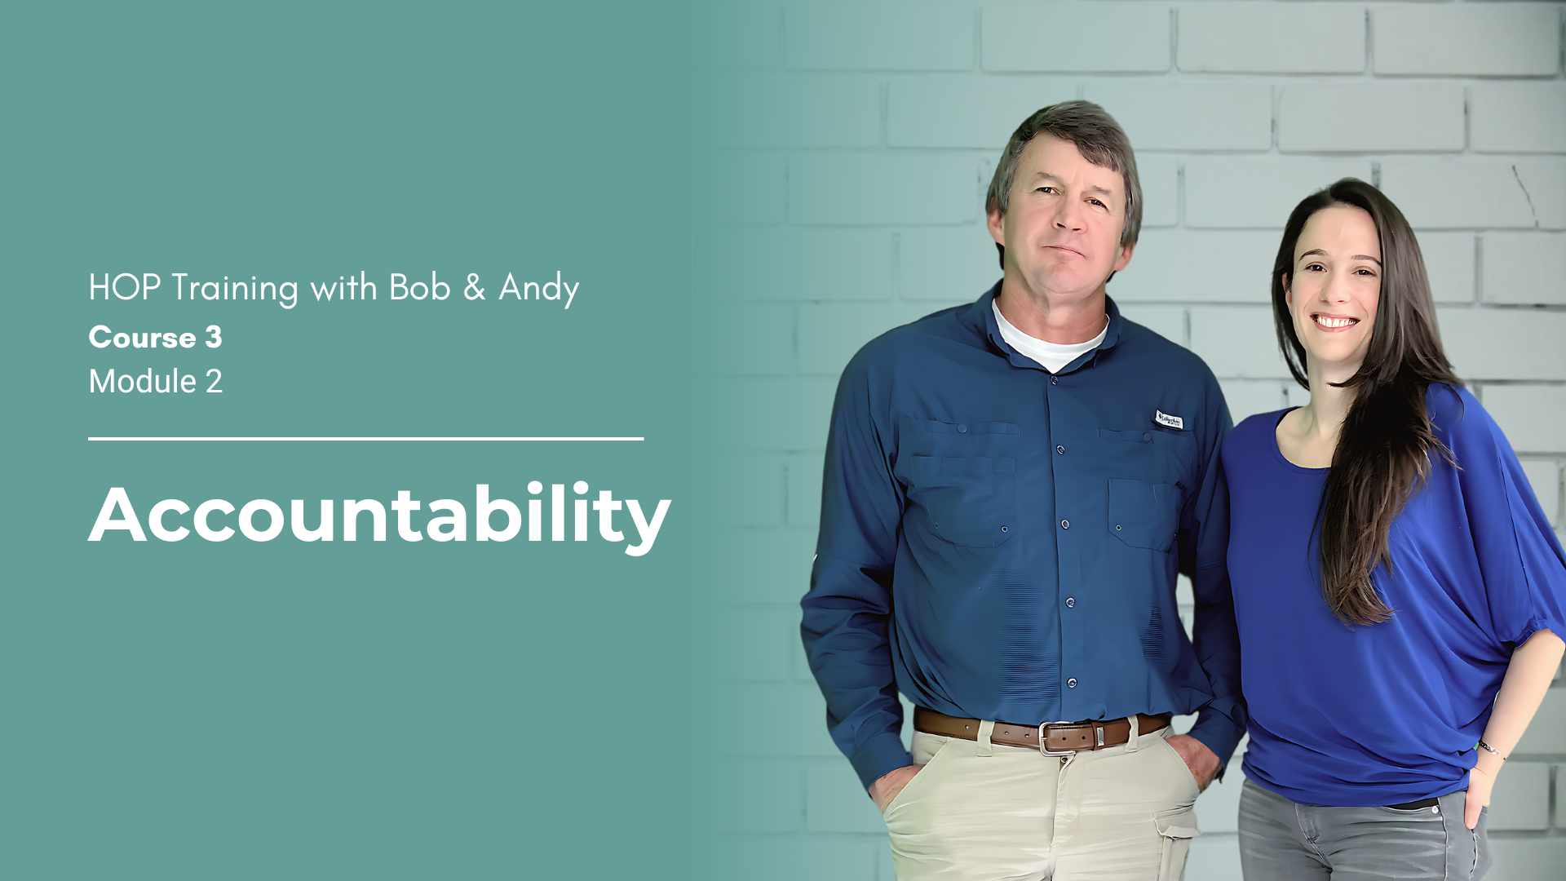
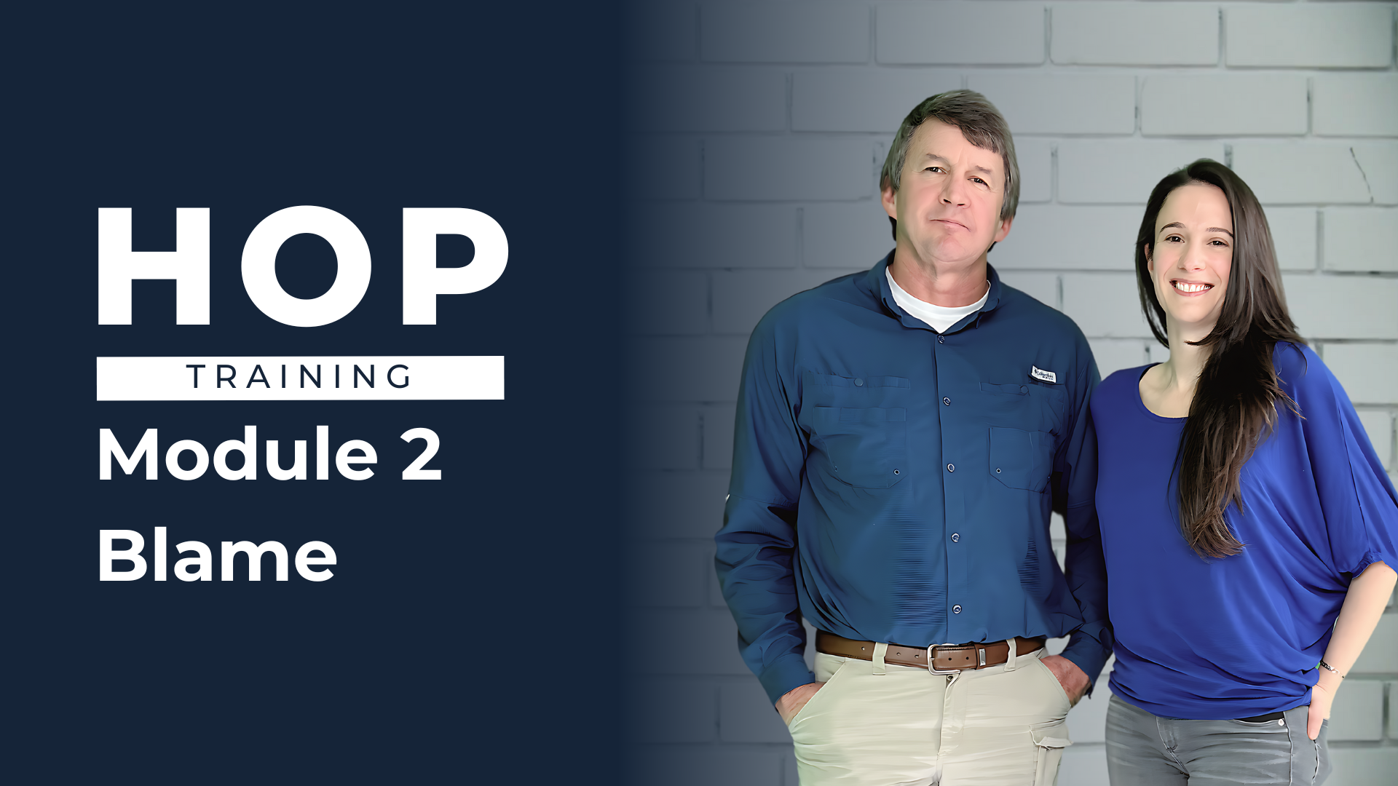
Debrief
Face-to-Face
Notes:
🔹 Flight Plan | Facilitator Preparation and Set-Up | 📍 Slide 1 of Blame| ⏱️ Prep Before Class | 📘 No Workbook Page | ⏳ Module Debrief Duration: ~60 min
Purpose: Prepare yourself, the room, and the conditions for a reflective debrief.
This slide is your pre-flight checklist. You will not present it to participants.
It exists to help you arrive grounded, prepared, and oriented toward guiding conversation with participants—not at them.
🔧 Pre-Class Tasks
Review the full module debrief flow
Revisit the online Blame module (especially how Bob and Andy frame the stories)
Review the participant workbook pages tied to this module
Prepare a warm, brief opening to establish tone and rapport
Decide whether Slide 2 (Safety Briefing) is needed based on context
Familiarize yourself with Slide 3’s framing language — this anchors expectations for the entire session
📝 Materials
Participant workbooks (Invitation to this session should ask participants to bring completed workbooks – see “Post eLearning Debrief Session Invite DRAFT”) in the Guides>Facilitator Guides>Post E-learning Debrief Session Facilitation folder
Pens or writing tools
Optional flipchart / whiteboard markers
🪑 Room Set-Up
Small group clusters or semicircle seating
Clear sightlines to the screen without awkward turning
📺 Technology Check
Test projector / display
Open slides in Presenter View so speaker notes are visible
- - - - - - - - - - - - - - - - - - - - - - - - - - - - - - - - - - - - - - - - - - - - - - - - - - - - - - - - - - - - - - - - - - - - - - - - - - - - - - - - - - - - - - - - - - - - - - - - - - - -
Facilitator Prep Notes
Activity Type: Facilitator preparation
Timing: Before participants arrive
Tip: This slide sets your mindset. Slow down here so you don’t rush later.

Slide 2
Safety Briefing
Notes:
🔹 Take Off | Safety Briefing | 📍 Slide 2 of Blame | ⏱️ 2 min | 📘 No Workbook Page
🎤 Facilitator Script:
"Before we begin, let’s quickly cover safety and emergency procedures for this session."
Emergency & Safety
Point out the nearest exits and the designated assembly point.
Note where the first aid kit and AED are located and identify the first aider if applicable.
Clarify the procedure for medical emergencies (e.g., call 911 or building security).
Facilities & Comfort
Indicate where washrooms are located.
Ask participants to keep walkways clear of bags or cords.
Let them know they can quietly step out at any time if needed.
Technology & Etiquette
Remind participants to silence phones.
Let them know it’s fine to step out for urgent calls.
Clarify whether photos of slides or materials are okay.
➡️ Optional Transition Line:
“Let’s start by getting to know each other—and setting the tone for the day.”
- - - - - - - - - - - - - - - - - - - - - - - - - - - - - - - - - - - - - - - - - - - - - - - - - - - - - - - - - - - - - - - - - - - - - - - - - - - - - - - - - - - - - - - - - - - - - - - - - - - -
Facilitator Prep Notes
Pre-Session Safety Checklist for Facilitators
Before the session, confirm and note down:
✅ Emergency exits — number, locations, and evacuation routes.
✅ Assembly point — where participants gather in case of evacuation.
✅ AED locations — confirm nearest AED and how to access it.
✅ First aid kit — location and responsible person(s).
✅ On-site emergency protocols — fire, medical, lockdown, etc.
✅ Building emergency contact numbers — reception/security if applicable.
✅ Washroom locations — nearest and accessible facilities.

Slide 3

Framing the Experience
What This Is (and Isn’t)
Notes:
🔹 Take-off | Framing the Experience | 📍 Slide 3 of Blame Module Debrief | ⏱ 3 min | 📘 No Workbook Page
🎤 Facilitator Script:
“Before we get to our content, I want to take a moment to frame what this session is—and what it isn’t.
This isn’t a time to debate the ideas or try to fix the whole organization. We’re not here to convince or clash, or to jump ahead into solutions. Instead, consider this space as a chance to experiment with new ways of seeing.
✅ It is a space to reflect on what landed with you
✅ It is a chance to hear diverse perspectives
✅ It is a way to revisit the stories and ideas and solidify your learning
🚫 It’s not a debate
🚫 It’s not about proving or defending positions
🚫 It’s not about changing policy today
We’re all at different points in our learning curve—and that’s okay. This is just one stop along the way, and you’re invited to explore it with curiosity.”
➡️ Optional Transition Line:
“Now that we’ve framed our session, let’s take a quick look back at what we each learned individually during the module.”
- - - - - - - - - - - - - - - - - - - - - - - - - - - - - - - - - - - - - - - - - - - - - - - - - - - - - - - - - - - - - - - - - - - - - - - - - -
Facilitator Prep Notes
Activity Type: Framing & expectation-setting
Timing: 3 minutes
Objective:
• Set psychological safety (do introductions if needed)
• Calibrate expectations
• Establish shared norms: meaning-making, not mastery or debate
Tips:
• Your tone sets the tone—speak calmly and with intention
• Use inclusive language (“we’re here together…”)

Slide 4
Module Recap: Blame
Blame is a natural human experience. It’s just not that helpful in solving problems.
This module explored:
Why blame shows up
Fundamental attribution error
Person vs. system problems and how to tell the difference
How blame hides learning
What changes when we get curious
Notes:
🔹 Altitude | Module Recap: Blame | 📍 Slide 4 of Blame Module Debrief | ⏱ 4 min | 📘 Workbook Pages 6–13
🎤 Facilitator Script:
“Before we move into reflection, let’s take a moment to recap together what this module explored.
Let me start by asking you:
What stood out to you as the main ideas this module was trying to unpack?”
“Here are a few of the core themes the module highlighted…”
(Paraphrase, don’t read verbatim.)
• Why blame shows up
• The fundamental attribution error
• The difference between person problems and system problems
• How blame hides learning
• What changes when we choose curiosity
➡️ Optional Transition Line:
“With that foundation, let’s revisit one of the most memorable parts of this module: the stories.”
- - - - - - - - - - - - - - - - - - - - - - - - - - - - - - - - - - - - - - - - - - - - - - - - - - - - - - - - - - - - - - - - - - - - - - - - - -
Facilitator Prep Notes
Activity Type: Summary + orientation + participant co-creation
Purpose:
• Invite participants to co-own the recap
• Reinforce shared meaning-making
• Anchor in core ideas before deeper reflection
Tips:
• Keep participant sharing brief
• Affirm answers neutrally
• Avoid deep explanation — this is grounding, not teaching

Slide 5
Blame Story Highlights
Which story stuck with you most—and why?
The Dog Gate and ‘Lazy’ Kids
Bob kept blaming his kids for laziness when the gate was left open, until he realized he forgot it too — and a simple system change fixed the issue.
Zero Strikes Left for Forklift Operators
A “three strikes” rule led to zero reported mistakes because operators were punished, not supported, when they spoke up. A Learning Team revealed what made those bumps inevitable.
Andy’s Solvent Story
Andy thought technicians mishandled dirty rags out of carelessness until she examined the actual task. Poor layout and hampering steps made the error predictable—showing it was a system issue, not a person problem.
Notes:
🔹 Altitude | Story Highlights | 📍 Slide 5 of Blame Module Debrief | ⏱ 6 min | 📘 Workbook Pages 6–13
🎤 Facilitator Script:
“Let’s bring back a few of the stories from the Blame module.
Stories help us see concepts, not just understand them, so I want to take a moment to surface what stood out.”
“Here are a few reminders to jog your memory:
• The Dog Gate story — Bob noticing his kids avoiding the gate and how quickly he labeled them as ‘lazy’ before noticing the design problem.
• The forklift operator with zero strikes left — a rule-based system that cornered a person instead of addressing the conditions underneath.
• Andy’s solvent disposal story — a moment where what looked like a ‘person problem’ was actually shaped by the way the system was set up.”
[
Pause — scan the room.]
“As you think about these, notice:
Which story stuck with you the most? Why?
And what does it help us see about why blame shows up so quickly?”
If the room is quiet, offer takeaways to anchor learning:
• The Dog Gate story shows how labeling people as “lazy” can hide the real issue.
• The forklift story shows how systems can trap people in no-win situations.
• The solvent story shows how system design can make the “wrong” choice the easiest one to make.
Optional Transition Phrase
➡️ “Now that the stories are fresh in our minds, let’s revisit some of the key ideas they helped illuminate.”
- - - - - - - - - - - - - - - - - - - - - - - - - - - - - - - - - - - - - - - - - - - - - - - - - - - - - - - - - - - - - - - - - - - - - - - - - -
Facilitator Prep Notes
Activity Type:
Recall + connection to narrative
Timing:
6 minutes
Objective:
• Help participants reconnect emotionally and cognitively to the stories
• Use narrative to deepen conceptual understanding
• Support recall without slipping into analysis or problem-solving
Tips:
• Keep the pace steady—stories are anchors, not the main discussion
• If the group is quiet, offer a quick reminder of the story
• Name the takeaway simply (“This story helps us see how conditions shape behavior”)
• Avoid adding new details or interpretations not in the module
• Maintain neutrality; the story belongs to the learner’s meaning-making

Slide 6
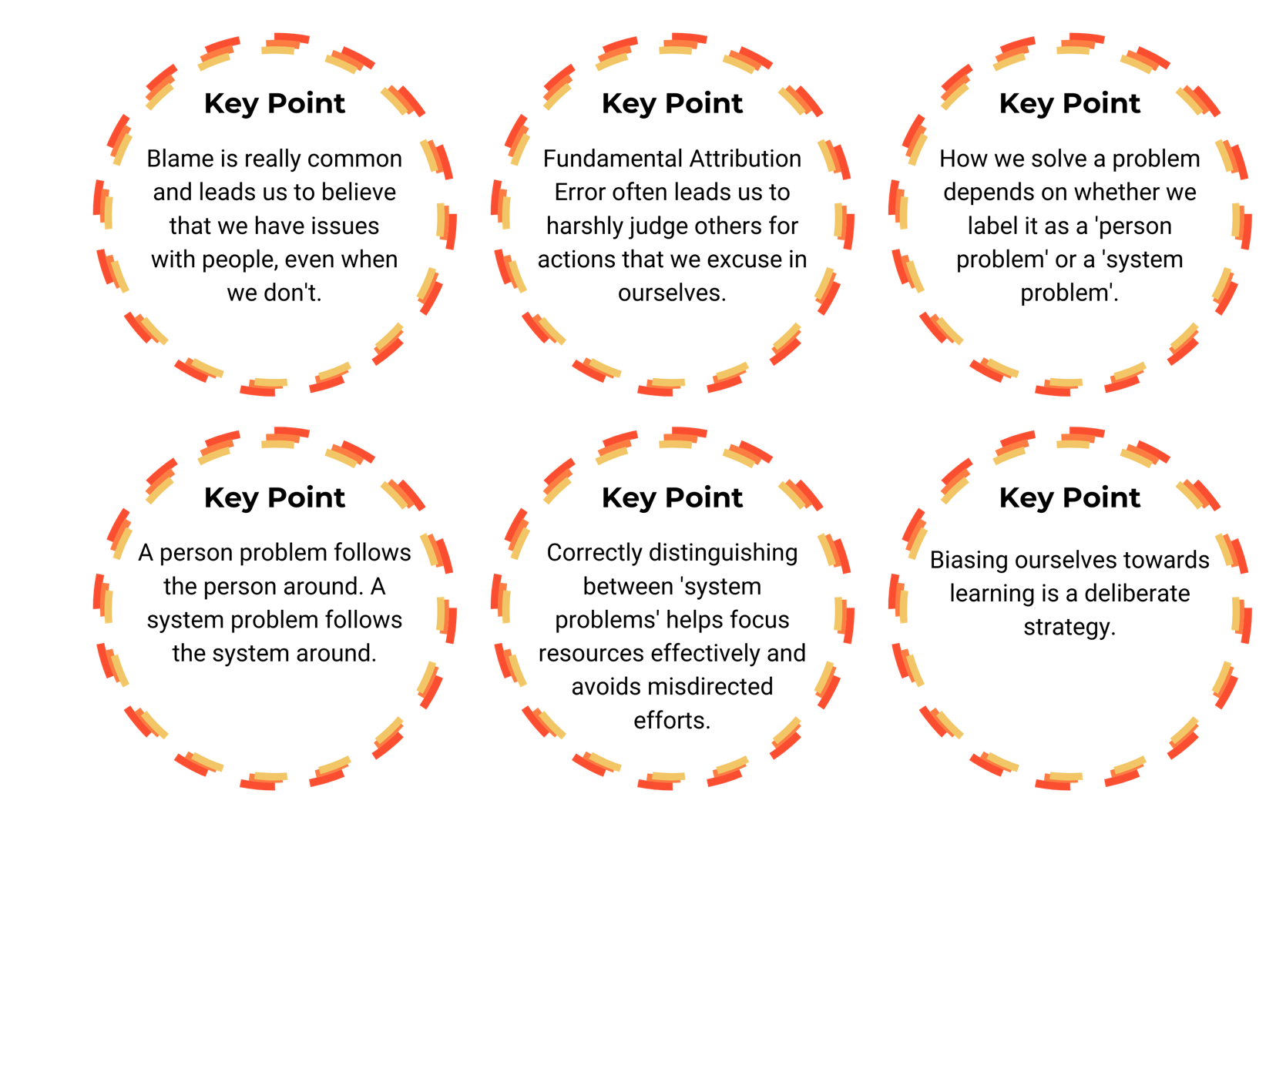

Key
Point
Recap
Which of these key points helps make sense of a challenge you’ve seen—or sparked a new perspective for you?
Notes:
🔹 Altitude | Key Point Recap | 📍 Slide 6 of Blame Module Debrief | ⏱ 6 min | 📘 Workbook Pages 6–13
🎤 Facilitator Script:
“As you look at these key points, ask yourself (example questions):
• Which of these makes more sense now?
• Where have you seen this show up at work recently?”
Which of these key points do you already align with in your leadership practices?
Which of these key points do you need to remind yourself of in the days/weeks to come.
Which of these keys point is more critical for our organization to grasp more deeply?
➡️ Optional Transition Line:
“These ideas came to life through your own reactions and experiences. Let’s explore what resonated or shifted for you personally.”
- - - - - - - - - - - - - - - - - - - - - - - - - - - - - - - - - - - - - - - - - - - - - - - - - - - - - - - - - - - - - - - - - - - - - - - - - -
Facilitator Prep Notes
Activity Type:
Synthesis + reconnection
Timing:
6 minutes
Objective:
• Reinforce the core concepts of the Blame module
• Help participants notice emerging connections
• Create a bridge between story, concept, and personal reflection
Tips:
• Give participants a moment to scan the key points silently
• Invite 1–2 brief observations
• Keep the energy moving — this is not a deep discussion slide
• Avoid correcting or “perfecting” participant interpretations
• Use this slide to prepare the group for deeper internal reflection next

Slide 7

What Resonated, Surprised, or Shifted?
Why did this stick with you?
What did it make you think about?
Has anything changed in how you see your own work or leadership?
Notes:
🔹 Altitude | What Resonated, Surprised, or Shifted? | 📍 Slide 7 of Blame Module Debrief | ⏱ 8 min | 📘 Workbook Pages 6–13
🎤 Facilitator Script:
“Let’s take a moment for some personal reflection.
Reflect on these questions — feel free to jot down a few notes if that helps you process.”
[Pause ~60 seconds.]
“Now, let’s hear a few thoughts from the group. There’s no pressure to share — offer something only if you feel comfortable.”
➡️ Optional Transition Line:
“Thank you for sharing. Let’s build on that by exploring how you applied these ideas through the homework challenge.”
- - - - - - - - - - - - - - - - - - - - - - - - - - - - - - - - - - - - - - - - - - - - - - - - - - - - - - - - - - - - - - - - - - - - - - - - - -
Facilitator Prep Notes
Activity Type:
Reflection + voluntary sharing
Timing:
8 minutes
Objective:
• Deepen personal meaning-making
• Surface insights that matter to participants
• Shift the room from cognitive summary → lived relevance
Tips:
• Allow at least 60 seconds of silence for reflection — don’t rush it
• Normalize all answers (“That’s a helpful reflection”)
• If sharing is slow, gently prompt (“Anyone have a moment that stood out?”)
• Avoid debating interpretations
• Keep focus on personal sensemaking, not case analysis
Boundaries:
• No naming individuals or incidents
• Keep the space reflective, not diagnostic or evaluative

Slide 8

Blame Homework Challenge
Debrief
What was a situation where you noticed yourself slipping into blame?
What was it like to pause, hold back judgment, and stay curious?
In what ways did you change how you asked questions?
How did people respond when you shifted from blaming to learning?
“I’m going to go learn what that person is facing until I have an understanding. And when we have that understanding, the judgment kind of fades away.”
- Bob
Notes:
🔹 Altitude | Blame Homework Challenge Debrief | 📍 Slide 8 of Blame Module Debrief | ⏱ 9 min | 📘 Workbook Pages 6–13
🎤 Facilitator Script:
“Now let’s talk about the Blame Challenge.
If you tried it, what was your experience like?
• What was a situation where you noticed yourself slipping into blame?
• What was it like to pause, hold back judgment, and stay curious?
• In what ways did you change how you asked questions?
• How did people respond when you shifted from blaming to learning?”
“You’re welcome to share if you’d like, and it’s also okay to simply listen.”
➡️ Optional Transition Line:
“Let’s shift from reflection into intention.”
- - - - - - - - - - - - - - - - - - - - - - - - - - - - - - - - - - - - - - - - - - - - - - - - - - - - - - - - - - - - - - - - - - - - - - - - - -
Facilitator Prep Notes
Activity Type:
Applied practice reflection
Timing:
9 minutes
Objective:
• Help participants reflect on how applying the module shifted their thinking
• Encourage curiosity around their own reactions and tendencies
• Reinforce the movement from blame → learning
Tips:
• Invite 1–3 brief shares; keep them concise
• Normalize both successes and struggles (“This is a hard habit to shift”)
• Redirect storytelling that becomes too detailed (“Let’s keep it general…”)
• If no one completed the homework, shift to:
“What situation could you imagine applying this to?”
Boundaries:
• No identifying real people or sensitive situations
• Keep focus on the experience of curiosity, not critiquing others

Slide 9
From Reflection to Action
So What? Now What?
As we wrap up, let’s shift from reflection to intention. What’s:
Something you want to pay closer attention to this week?
A conversation you’d like to approach differently after this module?
One place in your work where choosing curiosity could make a difference?
A practical next step you want to try before the next module?
Notes:
🔹 Landing | From Reflection to Action | 📍 Slide 9 of Blame Module Debrief | ⏱ 6 min | 📘 Workbook Page: N/A
🎤 Facilitator Script:
“As we wrap up, let’s shift from reflection to intention. Take a moment to consider:
• Something you want to pay closer attention to this week
• A conversation you’d like to approach differently
• One place where choosing curiosity could make a difference
• A practical next step you want to try before the next module
Take about 30 seconds to reflect.”
[Pause.]
“If you’re comfortable, feel free to share one intention aloud.”
➡️ Optional Transition Line:
“Let’s close with a look at what’s next.”
- - - - - - - - - - - - - - - - - - - - - - - - - - - - - - - - - - - - - - - - - - - - - - - - - - - - - - - - - - - - - - - - - - - - - - - - - -
Facilitator Prep Notes
Activity Type:
Intention-setting + forward momentum
Timing:
6 minutes
Objective:
• Help participants turn insights into small, meaningful next steps
• Reinforce curiosity as an actionable leadership habit
• Create psychological commitment without pressure
Tips:
• Give silent reflection time before asking for shares
• Encourage small, realistic intentions
• Affirm gently (“That’s a great shift”)
• Offer a sample intention if the group is stuck (“Maybe choosing curiosity in one tough moment this week…”)
Boundaries:
• Avoid making this feel like goal-setting or performance
• Keep the focus on experimentation, not perfection

Slide 10
Thank You & What’s Next
Keep the Reflection Going:
Learning is a process—this is just one step.
Stay curious. Stay open. Stay connected to those closest to the work.
We’ll revisit these ideas throughout the course.
The next module in this course is called “Complexity”.
Notes:
🔹 Landing | Thank You & What’s Next | 📍 Slide 10 of Blame Module Debrief | ⏱ 2 min | 📘 Workbook Page: N/A
🎤 Facilitator Script:
“Thank you for showing up and engaging today.
Learning is a process—not a checkbox. This is just one step along the way.
You don’t have to have everything figured out. Stay curious, stay open, and stay close to the people doing the work.”
➡️ Optional Transition Line:
“Our next module is Complexity. I’m looking forward to gathering again and continuing the conversation.”
- - - - - - - - - - - - - - - - - - - - - - - - - - - - - - - - - - - - - - - - - - - - - - - - - - - - - - - - - - - - - - - - - - - - - - - - - -
Facilitator Prep Notes
Activity Type:
Closure + preview
Timing:
2 minutes
Objective:
• Normalize ongoing learning and imperfect progress
• Affirm participation and curiosity
• Signal continuity into the next module (“Complexity”)
Tips:
• End with warmth and steadiness, not urgency
• Avoid inviting new discussion here
• Keep the final tone encouraging and spacious
• Make eye contact; let the group feel the close

